Slide 1
William shakespeare

Slide 2
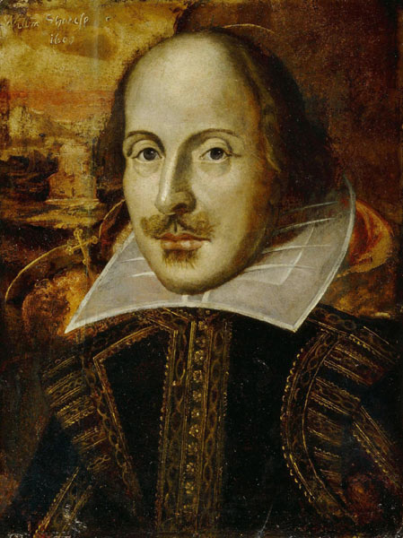
General information
William Shakespeare (bapt. 26 April 1564 – 23 April 1616) was an English playwright, poet and actor.
He is widely regarded as the greatest writer in the English language and the world's greatest dramatist.
He is often called England's national poet and the „Bard of Avon” (or simply „the Bard”).

Slide 3
General information – Shakespeare’s works
His extant works, including collaborations, consist of some 39 plays, 154 sonnets, three long narrative poems, and a few other verses, some of uncertain authorship.
His plays have been translated into every major living language and are performed more often than those of any other playwright.
His works continue to be studied and reinterpreted.

Slide 4
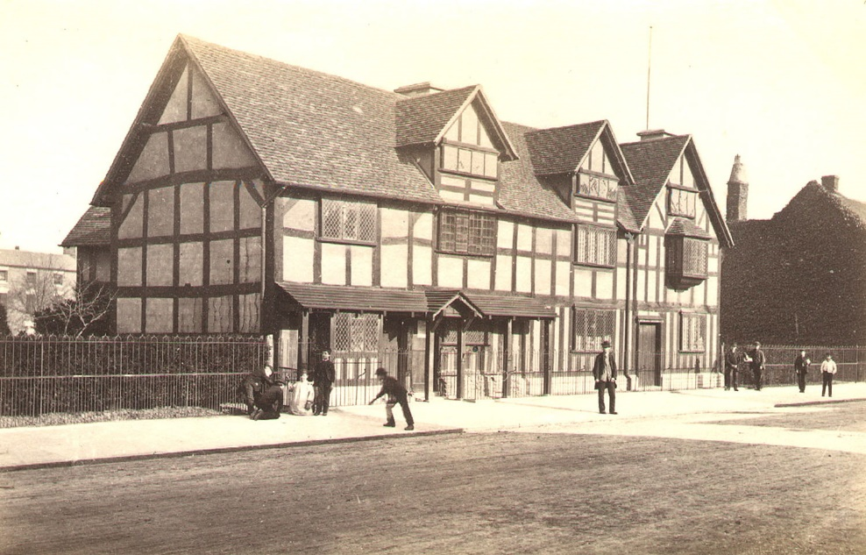
Birth and early life
He was born in Stratford-upon-Avon, where he was baptised on 26 April 1564.
His date of birth is unknown, but is traditionally observed on 23 April, Saint George's Day. It was also the day on which he has died.
Shakespeare attended to the King’s Grammar School in Stratford. The school taught boys basic reading and writing.
Shakespeare’s birthplace

Slide 5
Family
William was the third child of eight, and first son, of John and Mary Shakespeare.
John Shakespeare was a maker of leather goods such as purses, belts and gloves. He was also a prominent man in Stratford. By 1560, he was one of fourteen members of the town council.
His mother, Mary Shakespeare (born Mary Arden), was a daughter of an affluent landowning family.

Slide 6
Marriage and children
On November 28th, 1582 William married Anne Hathaway of Stratford. Anne was 26. Some years later, William had abandoned the family.
William’s first child, Susanna, was baptized in Stratford sometime in May, 1583.
His twins, Hamnet and Judith, were born in February 1585. Hamnet, who was William's only son, died in 1596 at just eleven years old.

Slide 7
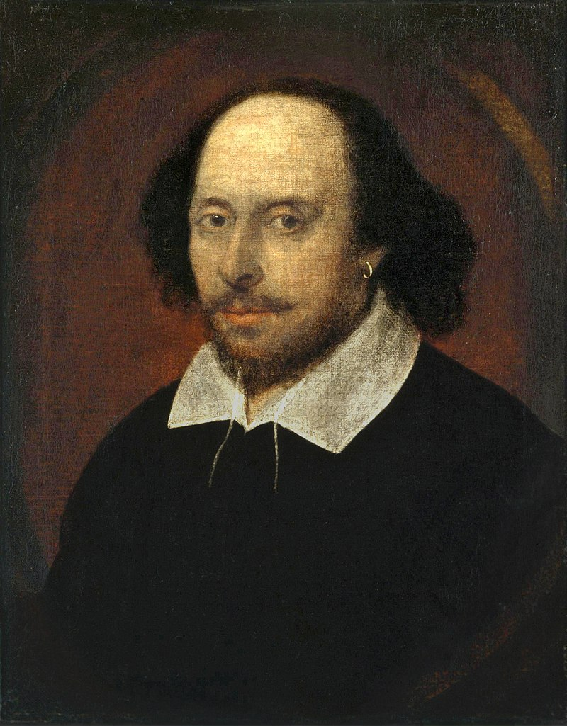
The Lost Years (1585-1592)
From the time after his twins are born until 1592, little is known about him. All that’s known is that he moved to London to write for the theater.

Slide 8
Rise to fame
By 1592, Shakespeare was established in London as a playwright and poet.
In January of 1593, the theaters in London closed because of the plague and remained closed until spring of 1594. Shakespeare wrote much of his poetry during this time.

Slide 9
Career
In December of 1594, along with Will Kemp, Richard Burbage and 4 others, Shakespeare started a new theater company called The Lord Chamberlain’s men.
By 1599, the Lord Chamberlains Men had become the most popular acting group in London.

Slide 10
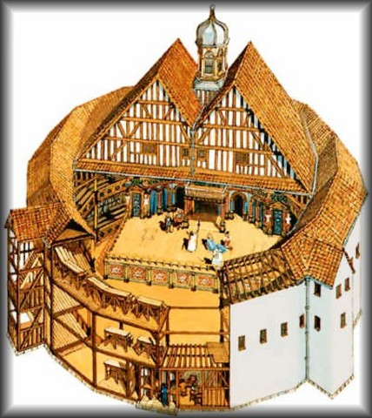
The Globe theater
In 1599, a theater in London was rebuilt and renamed The Globe. It was a three-story building along the bank of river Thames. Shakespeare became part owner of the new theatre and became wealthy. His plays were often displayed there.

Slide 11
Shakespeare’s works

Slide 12
introduction
Shakespeare wrote at least 38 plays and over 150 short and long poems, many of which are considered to be the finest ever written in English. His works have been translated into every major living language. At over 400 years after his death, they still continue to be performed around the world.

Slide 13
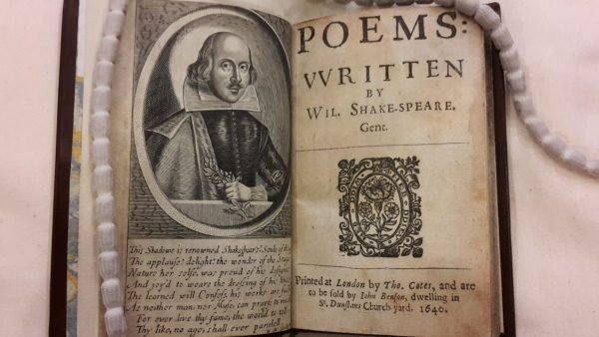
Poems
Shakespeare has written five long poems. They are: - Venus and Adonis (1593) - Rape of Lucrece (1594) - Passionate Pilgrim (1598) - Phoenix and the Turtle (1601) - Lover's Complaint (1609)

Slide 14
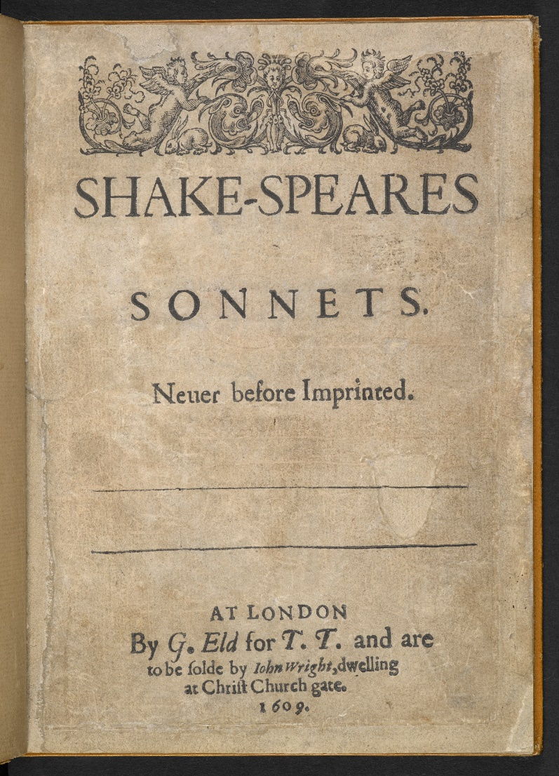
sonnets
Shakespeare has written 154 sonnets on the topics of love, beauty, morality and politics. They were published in 1609, making them the only Shakespeare work to be published as he was still alive.
Original edition of the Sonnets from 1609

Slide 15
Plays - comedies
Shakespeare wrote 14 comedies:
- All's Well That Ends Well (1602–1603) - As You Like It (1599–1600) - The Comedy of Errors (1592–1593) - Love's Labour's Lost (1594–1595) - Measure for Measure (1604–1605) - Merchant of Venice (1596–1597) - Merry Wives of Windsor (1600–1601) - Midsummer Night's Dream (1595–1596) - Much Ado about Nothing (1598–1599) - Taming of the Shrew (1593–1594) - Tempest (1611–1612) - Twelfth Night (1599–1600) - Two Gentlemen of Verona (1594–1595) - Winter's Tale (1610–1611)

Slide 16
Plays - Histories
Shakespeare wrote 11 histories:
- Henry IV, Part I (1597)
- Henry IV, Part II (1597)
- Henry V (1598)
- Henry VI, Part I (1589)
- Henry VI, Part II (1590)
- Henry VI, Part III (1591)
- Henry VIII (1612)
- King John (1596)
- Pericles (1608)
- Richard II (1595)
- Richard III (1592)

Slide 17
Plays - tragedies
Shakespeare wrote 12 tragedies:
Antony and Cleopatra (1606–1607)
Coriolanus (1607–1608)
Cymbeline (1609–1610)
Hamlet (1600–1601)
Julius Caesar (1599–1600)
King Lear (1605–1606)
Macbeth (1605–1606)
Othello (1604–1605)
Romeo and Juliet (1594–1595)
Timon of Athens (1607–1608)
Titus Andronicus (1593–1594)
Troilus and Cressida (1601–1602)

Slide 18
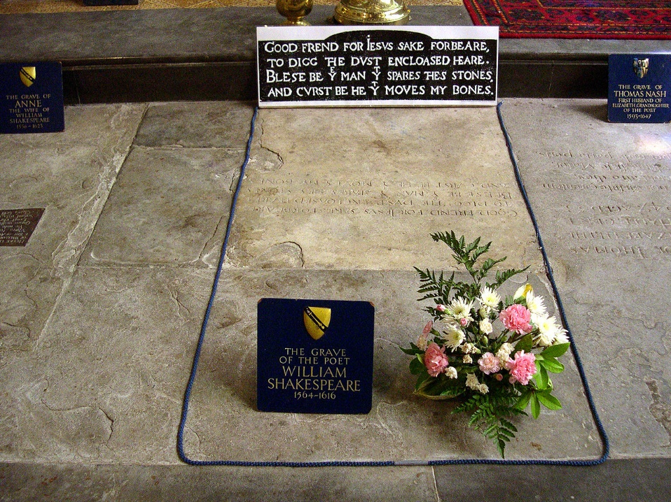
Death and epitaph
On April 23, 1616, William Shakespeare died in his hometown of Stratford-upon-Avon at the age of fifty-two. His death occurred on or near his birthday (the exact date of his birth remains unknown).
He is buried at the Holy Trinity Church in Stratford.
Shakespeare’s grave

Slide 19
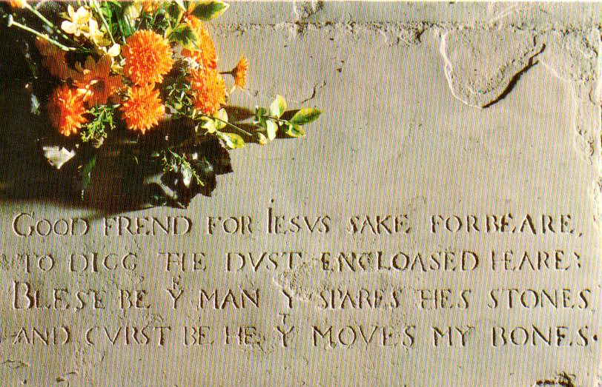
Epitaph
Shakespeare wrote an epitaph that was inscribed on his tombstone as a warning to grave-robbers.
„Good frend for Iesvs sake forbeare, To digg the dvst encloased heare. Bleste be y man y spares thes stones, And cvrst be he y moves my bones.”

Slide 20
Thank you for your attention
Made by jakub chudynko

